Slide 1

Customer Churn Analysis
Telecom Case Study
Rahul Sharma | Product / Business Analyst

Slide 2

Business Problem
High Churn Rate
Costly Acquisition
Unknown Drivers
Telecom company experiencing significant customer loss
Customer acquisition costs are rising
Need to identify key churn factors
Retention Goal
Reduce churn and improve customer loyalty

Slide 3
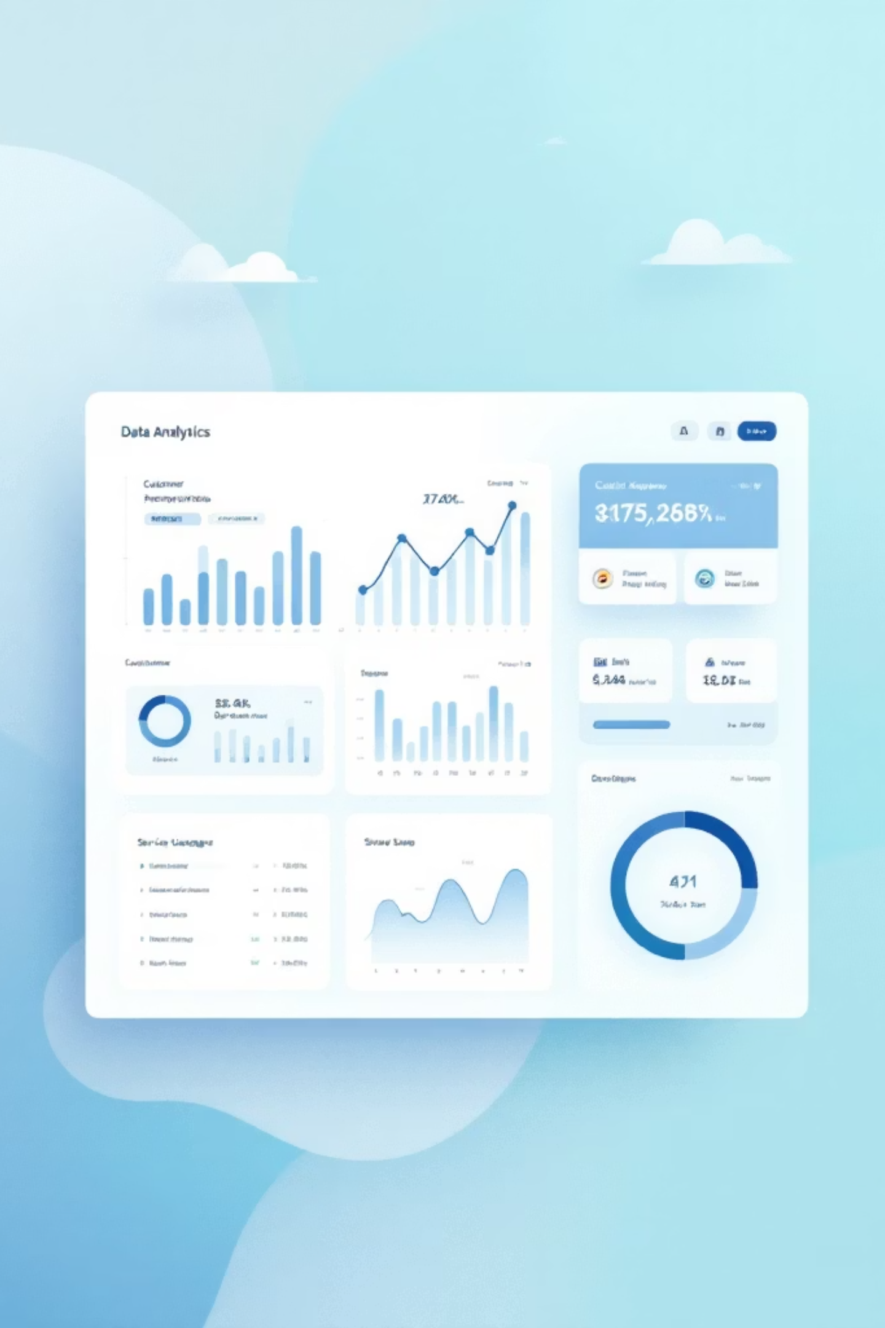
Dataset Overview
7,043
21
Total Customers
Features
Analyzed across all segments
Demographics, services, billing data
Target variable: Churn (Yes/No). Data cleaned and modeled using SQL and Power BI for comprehensive analysis.

Slide 4





Key Performance Indicators
Total Customers
Churn Customers
Churn Rate
Complete customer base tracked
Customers who left the service
Percentage of customer loss
Avg Monthly Charges
Revenue at Risk
Revenue per customer metric
Potential revenue loss from churn

Slide 5

Key Insights
Month-to-Month Contracts
Electronic Check Users
Missing Support Services
Fiber vs DSL
Fiber users churn more than 2x compared to DSL
Highest churn rate at 42%+
Significantly higher churn at 45%+
Customers without Tech Support & Security show 40%+ churn

Slide 6

Root Cause Analysis
Low Customer Stickiness
Short-term commitment creates weak loyalty
Limited Value Services
Lack of bundled value-added offerings
Price Sensitivity
Customers seeking better deals elsewhere
Poor Segment Engagement
Certain customer groups underserved

Slide 7
STRATEGIC RECOMMENDATIONS
Action Plan to Reduce Churn
1
2
3
4
Contract Strategy
Payment Strategy
Service Bundling
Service Targeting
Promote annual & 2-year plans with bundled discounts
Incentivize auto-pay methods over electronic checks
Bundle Tech Support + Online Security packages
Target fiber customers with retention offers
Expected Impact: Increase perceived value
Expected Impact: Reduce churn and boost profit
Expected Impact: Reduce churn by 5–8%
Expected Impact: Improve retention & cash flow

Slide 8





Business Impact
5–10% Churn Reduction
Higher Lifetime Value
Measurable decrease in customer loss
Increased revenue per customer
Lower Acquisition Costs
Revenue Stability
Reduced pressure on new customer spend
Improved recurring revenue streams

Slide 9
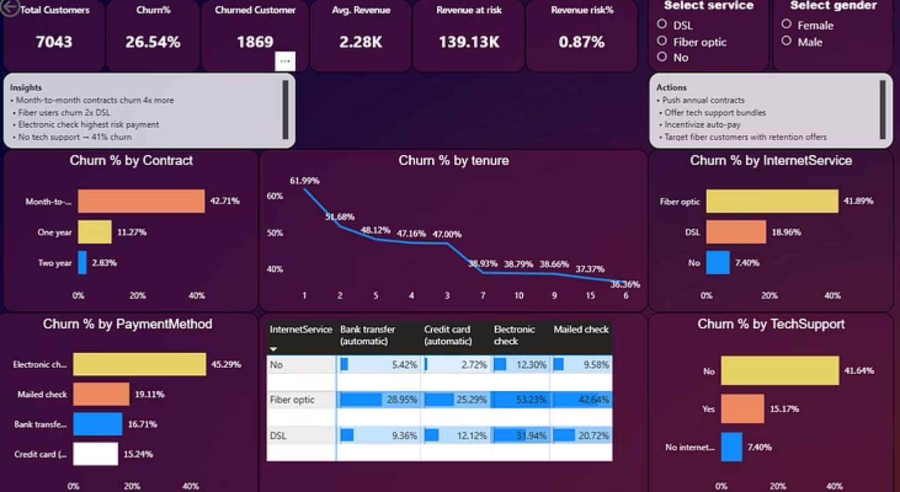
Dashboard Overview
Comprehensive Power BI dashboards provide real-time insights into churn patterns, contract performance, payment methods, and service utilization across all customer segments.

Slide 10



Next Steps
01
02
Implement Recommendations
Monitor KPIs
Track churn rate and retention metrics
Roll out contract and payment strategies
03
Iterate & Optimize
Refine strategies based on results
By focusing on customer retention through targeted strategies, we can significantly reduce churn and build a more sustainable, profitable customer base.

